Slide 1
A Car Rental Web-Application
Github repository-/https://github.com/kalpesh461/car-rental.git

Slide 2
Purpose
Project Aim:
The Car Rental Web Application aims to provide a secure, efficient, and user-friendly online platform for individuals and small businesses to rent vehicles and manage their rental activities.

Slide 3
ARCHITECTURE DIAGRAM OF WEB APPLICATION
jj
HOME
RENT
SERVICES
CONTACT US
User type:
1.Individual User
2. Small bussiness
Front end
API
database server
API Server
User
mail

Slide 4
Overview of technology
HTML-It's the language used to create web pages, like setting up the structure and adding things like text, images, and links.
CSS-This makes your web page look good. It changes how things like colors, fonts, and spacing appear on the page.

Slide 5
JAVASCRIPT-This adds cool stuff to your web page, like animations or checking if you typed your email correctly in a form.
API- Instead of PowerPoint, you can use CSS to make slide presentations on the web. It lets you design and move between slides in a stylish way.

Slide 6
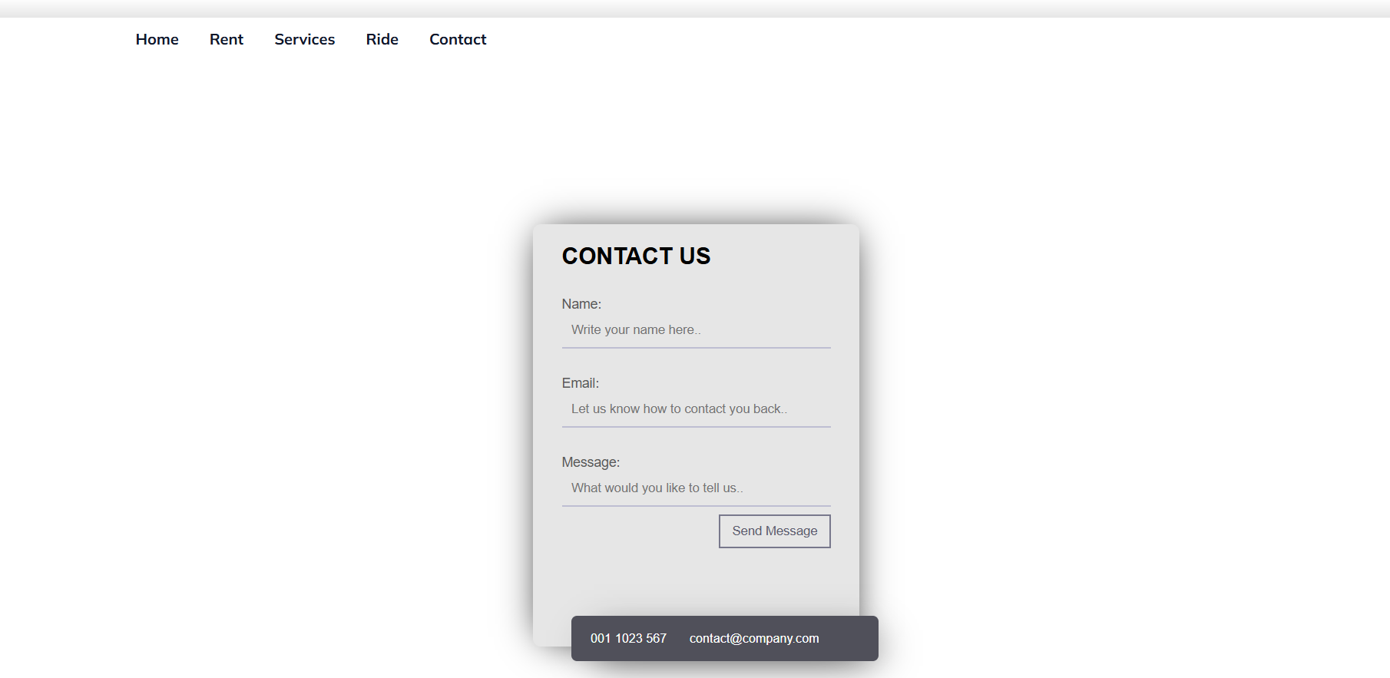
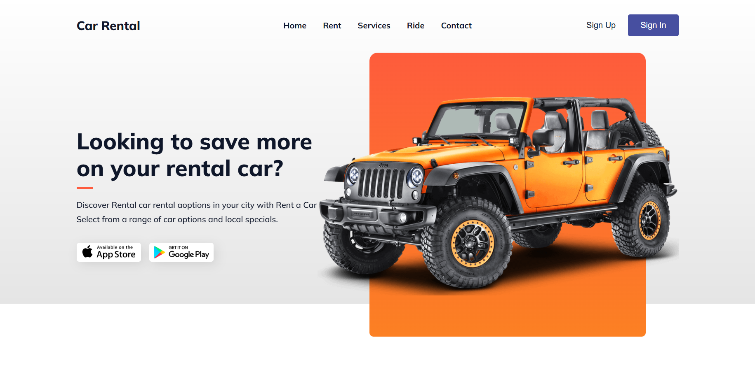
SCREENSHOT

Slide 7
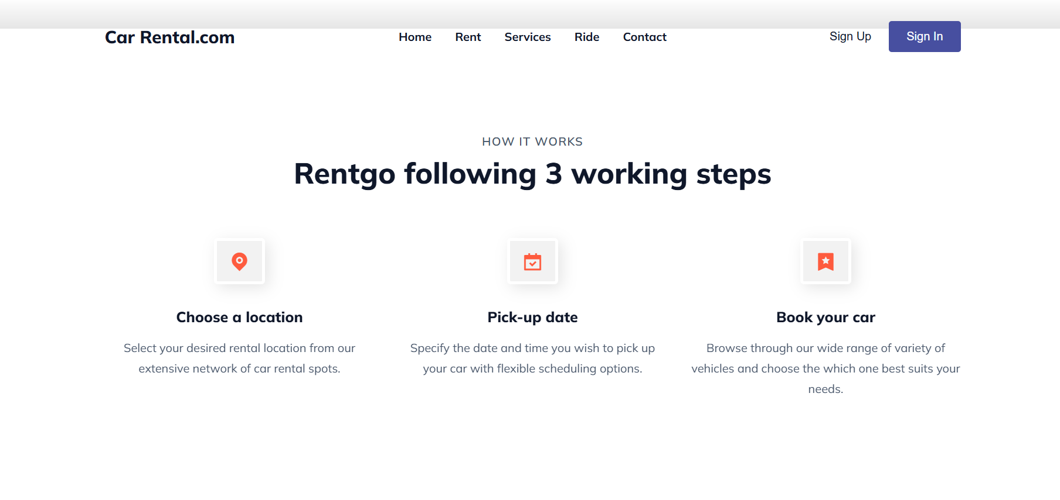
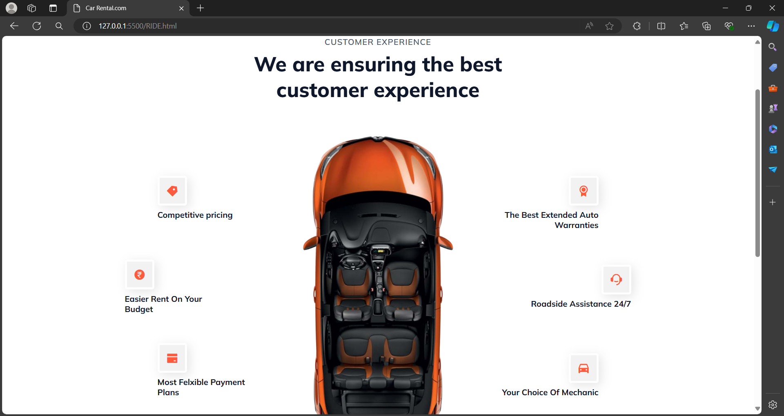

Slide 8
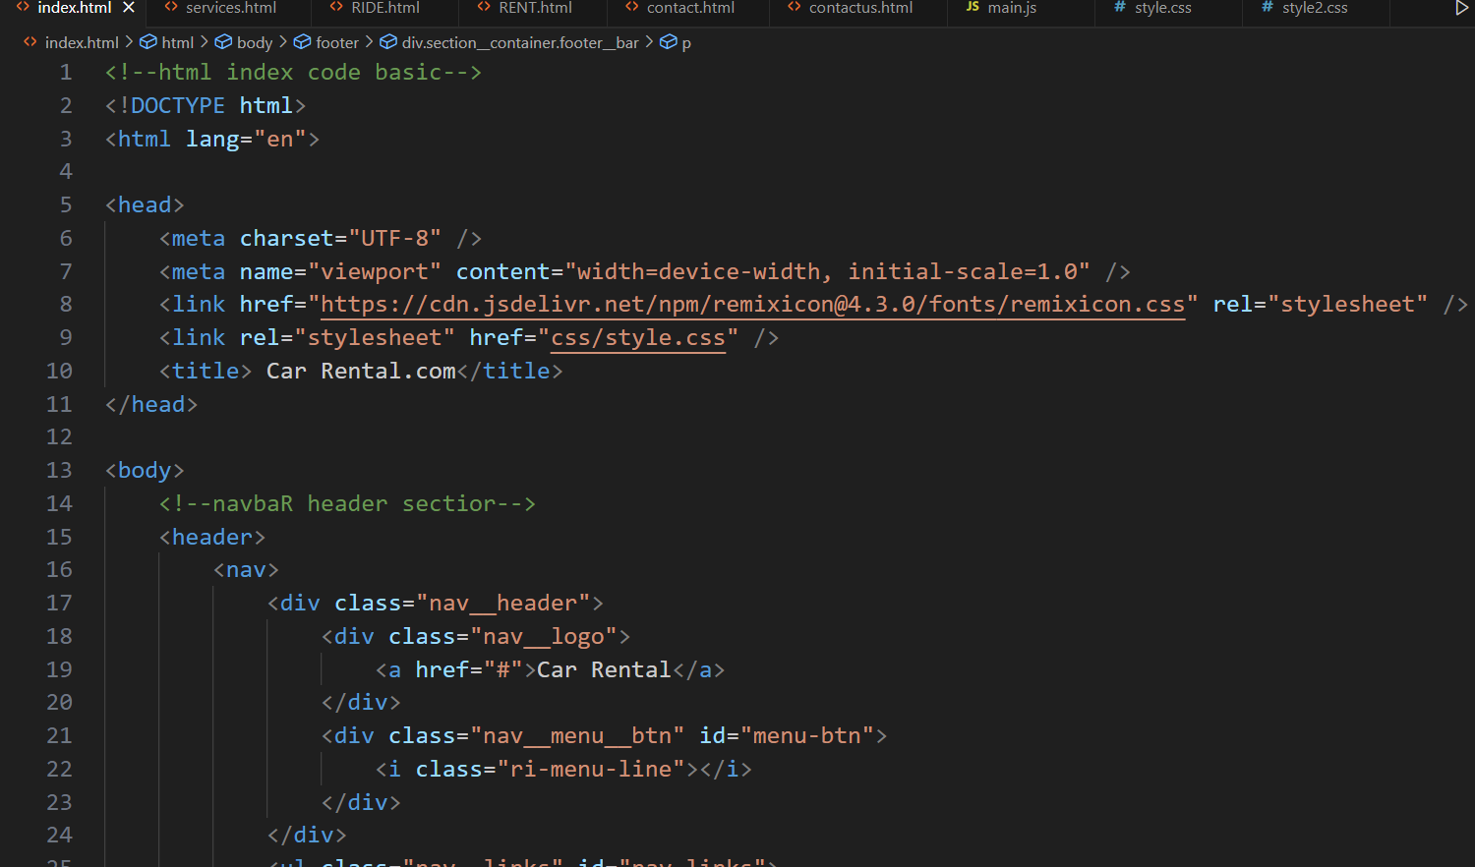
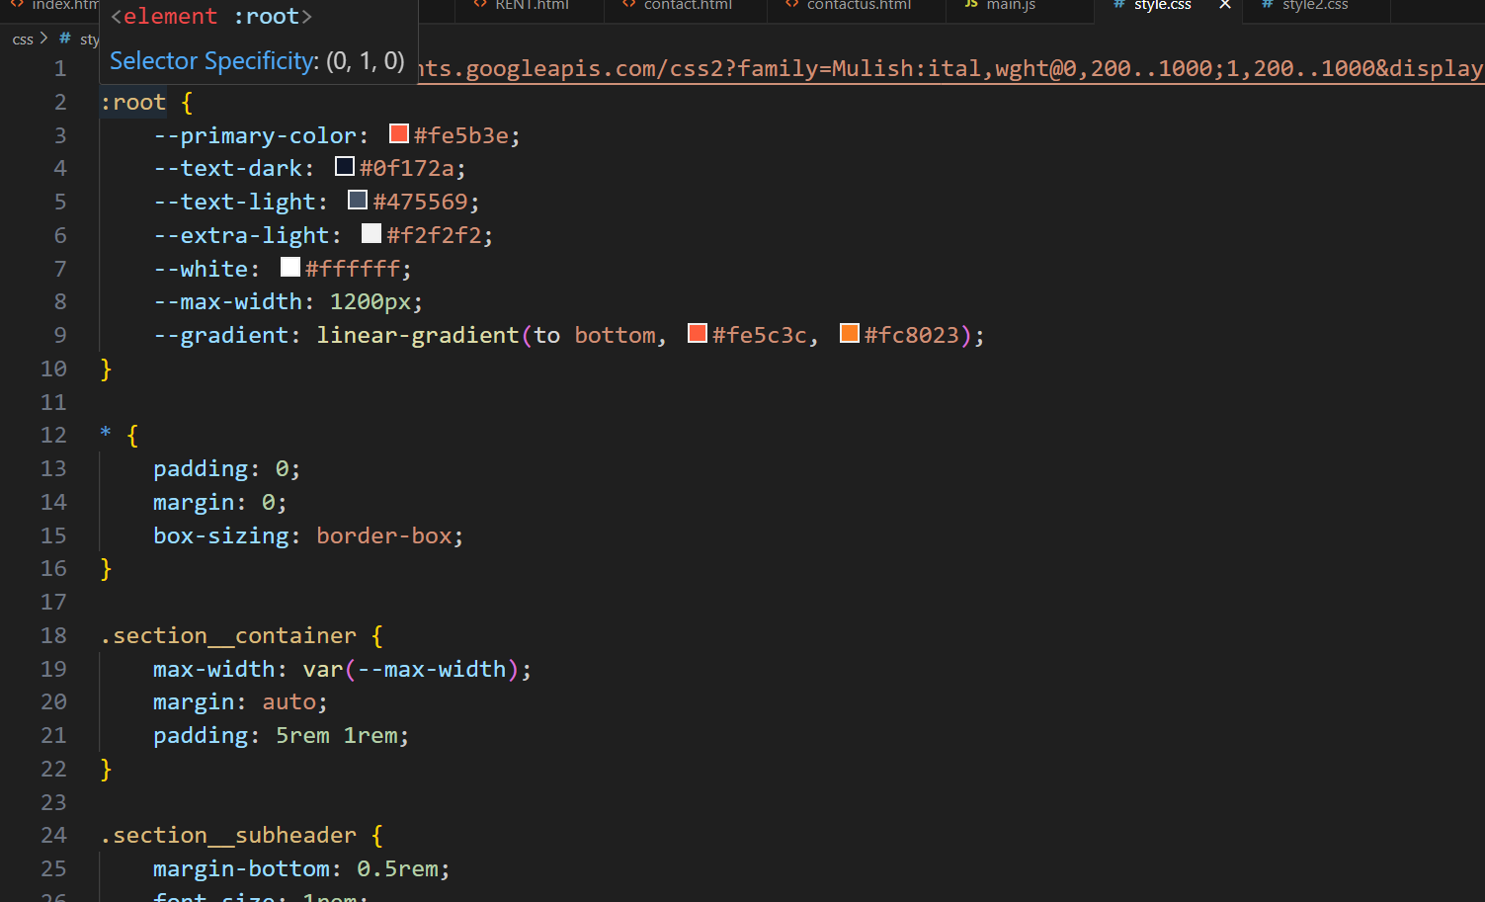
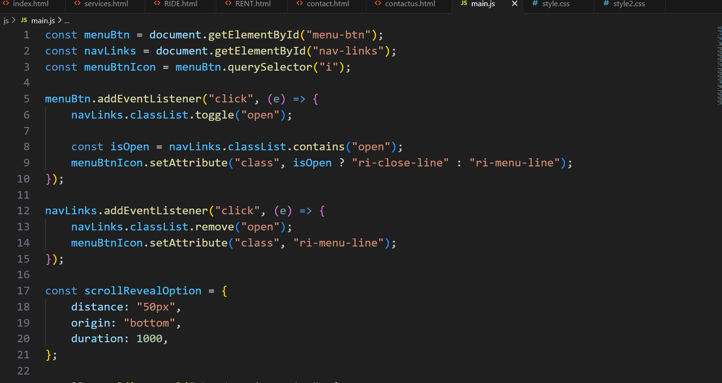
CODE OF HTML,CSS and JavaScript

